Slide 1
Group 8
Revision 0 Presentation
Supervisor: Dr. Gonsamo

Slide 2
Project Overview
Current Achievement
Project Demo
Future Plan
Contents

Slide 3
01
Project Overview
Project Name: Digital Twin Forest
Major Task:
Create forest model
Forest data visualization
Purpose:
Scientific research for Dr. Gonsamo's Lab
Group Information:
Bowen Zhang
Yichen Jiang
Jiacheng Wu
Junhong Chen
Tingyu Shi

Slide 4
02
Current Achievement
Data Collection
Data were collected from Turkey Point Forest.
Our team scanned trees from plot 14 during the reading week last semester.
Other data like LAI, DBH, etc. were collected from Dr. Gonsamo’s lab.
Modeling
We built the terrain of the forest including models of oak, pine, birch, etc. We also added post processing effects such as skybox and lighting
Function
We have implemented an interactive software that can visualize the forest data we collected. We also implement other features including updating data and summarizing data.

Slide 5
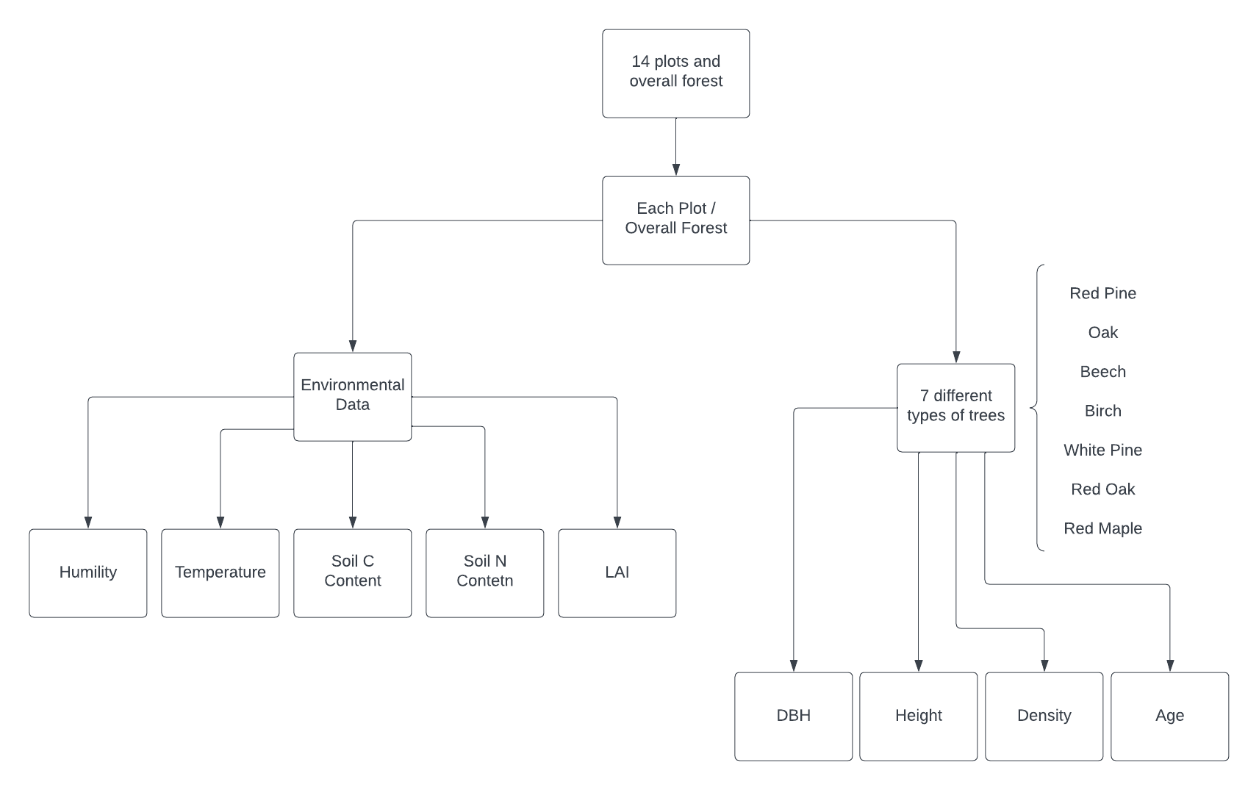
03
Project Demo

Slide 6
04
Future Plan
Seasonal change of the forest environment.
Shaders for tree models.
Update forest data after Dr. Gonsamo's Lab finishes processing latest data.
Sound effects.
Make buttons more interactive.

